Slide 1
Category review: Chips
February 2026
Retail Analytics
Brand note: If client logo is not required, use alternate title page layout right click slide thumbnail > Layout > Title

Slide 2
Notes:
To view Privacy video explaining how important data privacy is to Quantium, please click here: https://www.youtube.com/watch?v=Zq1QDAkoRzU
or here Q:\Company Reference\Brand & Design\Brand videos\Q Privacy.mp4
At Quantium, we believe that data is the behavioural footprint of humanity and that it has to be treated with the utmost care and responsibility.
Histories, attitudes, indeed lives are stored within it in ways that aren’t always apparent – and that’s what makes its potential so powerful.
To work with it responsibly, sensitively, we set ourselves the highest data privacy protection and governance standards.
We have spent 17 years perfecting privacy-by-design and secure-by-design principles. Central to this is not holding any personally identifiable information about people –
we neither receive it, and put the necessary protections in place to be unable to decipher it.
Every aspect of handling data is safeguarded: from its de-identification, to its encryption – data security is paramount and of the highest grade.
We pride ourselves on gaining the trust of iconic organisations around the world through years of securely working with their data,
and in turn the trust that builds with their stakeholders.

Slide 3
Executive summary
01
Task 1
The number of chips transactions dramatically increases prior to Christmas. Thus, added visibility to customers via a promotional display or Gondola end would increase purchases driving sales growth over this holiday period.
Mainstream Young Singles & Couples are the primary shopper of Chips.
Young and Older Families make up 26% of Chips shoppers and on average purchase larger baskets. There is more opportunity for sales with these shoppers.
02
Task 2
A control store was constructed to reflect the prior performance of the selected trial store.
After implementing the new store layout the performance of the trial store and the control store were compared. The trial store saw significant uplift from the new store layout.

Slide 4
01
Category

Slide 5
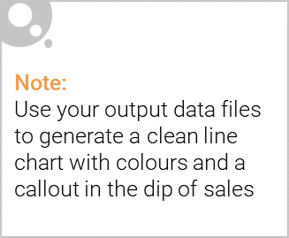
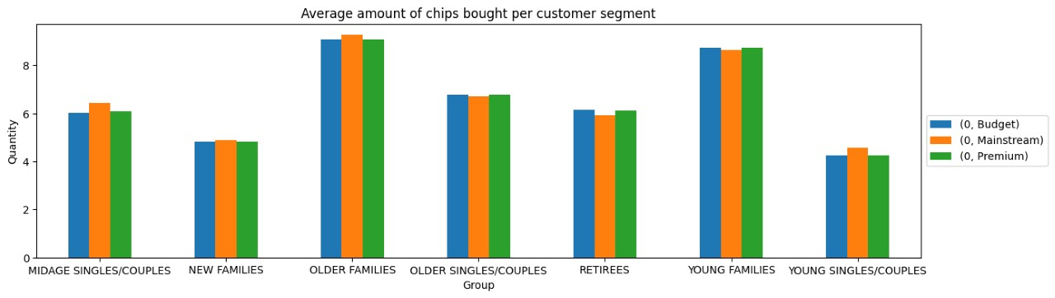
HISTOGRAM OF AVERAGE AMOUNT OF CHIPS BOUGHT PER CUSTOMER SEGMENT

Slide 6
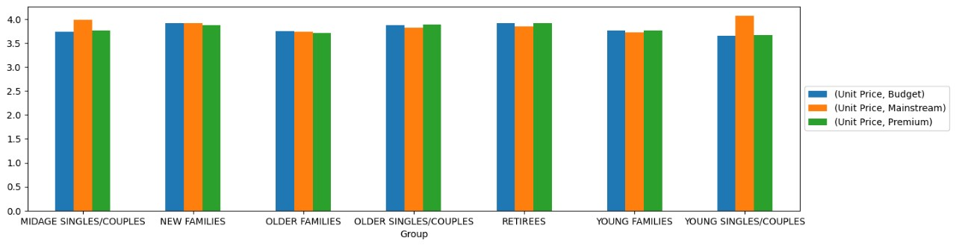
AVERAGE CHIPS PRICE PER TRANSACTION BY SEGMENTS

Slide 7
RECOMMENDATIONS
1/ OLDER FAMILIES - Focus on the Budget Segment. - Strength: Frequent Purchase. We can give promotions that encourages more frequency of purchase. - Strength: High quantity of chips are purchased per visit. We can give promotions that encourage them to buy more quantity of chips per purchase.
2/ YOUNG SINGLES/COUPLES - Focus on the Mainstream Segment. - This segment is the only segment that had "Doritos" as their 2nd most purchased brand (after "Kettle"). To specifically target this segment it might be a good idea to collaborate with "Doritos“ merchant to do some branding promotion catered to "YOUNG SINGLES/COUPLES Mainstream" segment. - Strength: Population quantity. We can spend more effort on making sure our promotions reach them, and it reaches them frequently.
3/ RETIREES - Focus on the Mainstream Segment. - Strength: Population quantity. Again , since their population quantity is the contributor to the high total sales, we should spend more effort on making sure our promotions reaches as many of them as possible and frequent.
4/ GENERAL - All segments has "Kettle" as the most frequently purchased brand, and175g (regardless of brand) followed by 150g as the preferred chips size. – When promoting chips in general to all segments it is good to take advantage of these two points.

Slide 8
02
Trial store performance

Slide 9
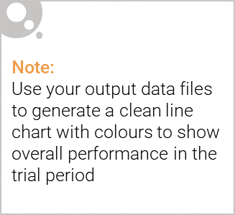
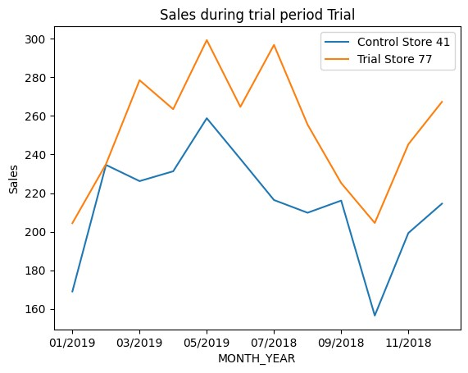
LETS START WITH STORE 77 & 41
For the first pair we can see a clear difference between the trial store and the control store.

Slide 10
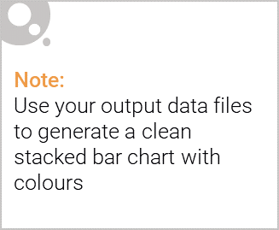
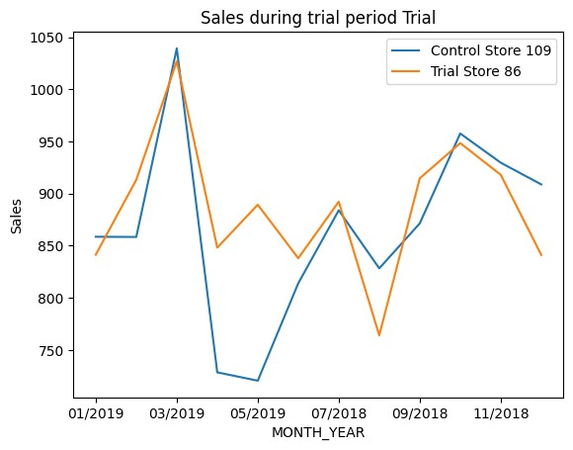
Editable (delete this)
LETS START WITH STORE 86 & 109
For the second pair we can see a clear difference between the trial store and the control store. Lets look at the next pair of stores.

Slide 11
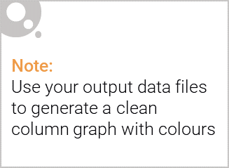
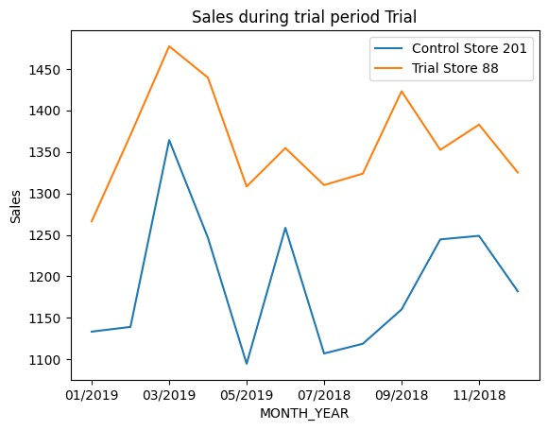
LETS START WITH STORE 88 & 201
For the third pair we can see a clear difference between the trial store and the control store.

Slide 12
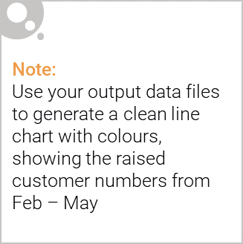
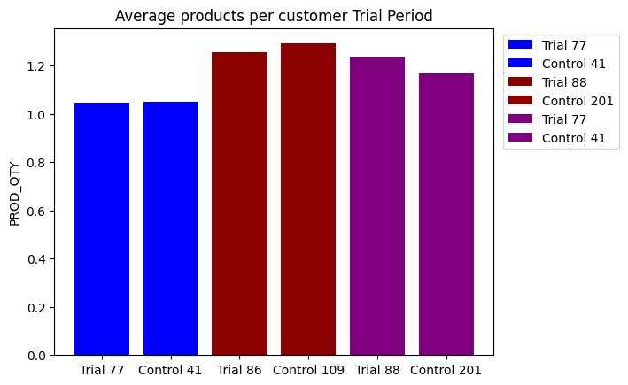
Average products per customer Trial Period

Slide 13
CONCLUSION
As we can see the average transactions were slightly higher for 1 of the 3trial stores.
I believe the new layout is working to increase sales.
Sales, products sold , amount of repeat customers and average transactions per customer all show signs that’s the trial stores are outperforming the control stores.
My recommendation would be to increase the amount of trial stores and to run another analysis in 3 months to see if the increased sales stay true and stabilize at a higher point.

